Slide 1
Swedbank IT Academy 2022 OOP Basics Part II
Deividas Kybartas

Slide 2
Agenda
Inheritance
Polymorphism
Overloading
Overriding
Encapsulation
Abstraction
Interfaces and abstract classes
Exceptions

Slide 3
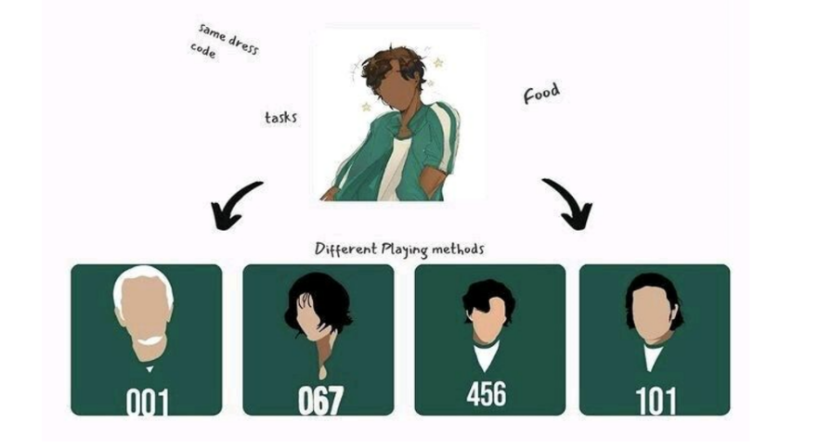
Inheritance
All players inherit the same parent properties like dress, food, tasks. With that ca have a different player with different playing strategical methods.
Inheritance allows classes to inherit common properties from the parent class.

Slide 4
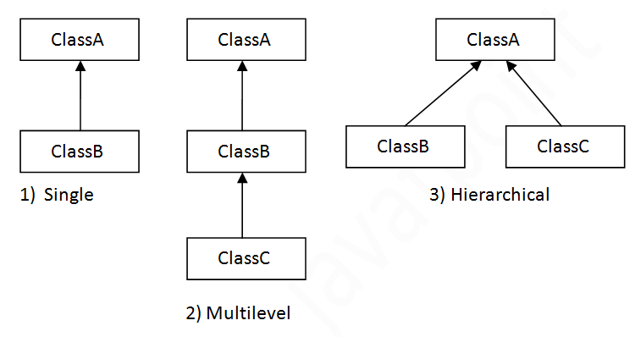
Inheritance
Inheritance, what you need to know?
Sub Class/Child Class
Super Class/Parent Class
Single
Multilevel
Hierarchical
Keywords extends, super

Slide 5
Task 1

Slide 6
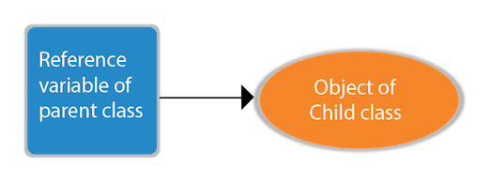
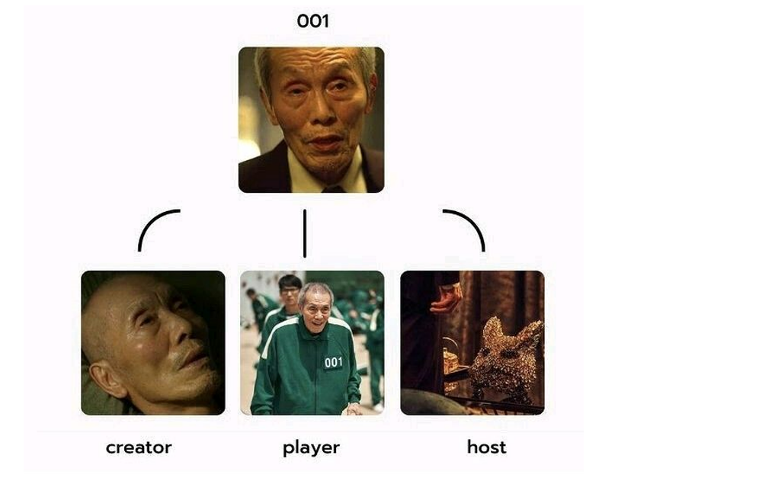
Polymorphism
The old man(001) played roles in many forms as the creator, player, and host of the game.
Polymorphism is the ability to exit in many forms

Slide 7

Encapsulation
Squid Game itself is a big Encapsulation. Combination of frontman, VIP, Host, Players, Money (consider as variables), Tasks (consider as a function) makes the Squid Game.
Encapsulation means it binds data and code together into one unit.

Slide 8
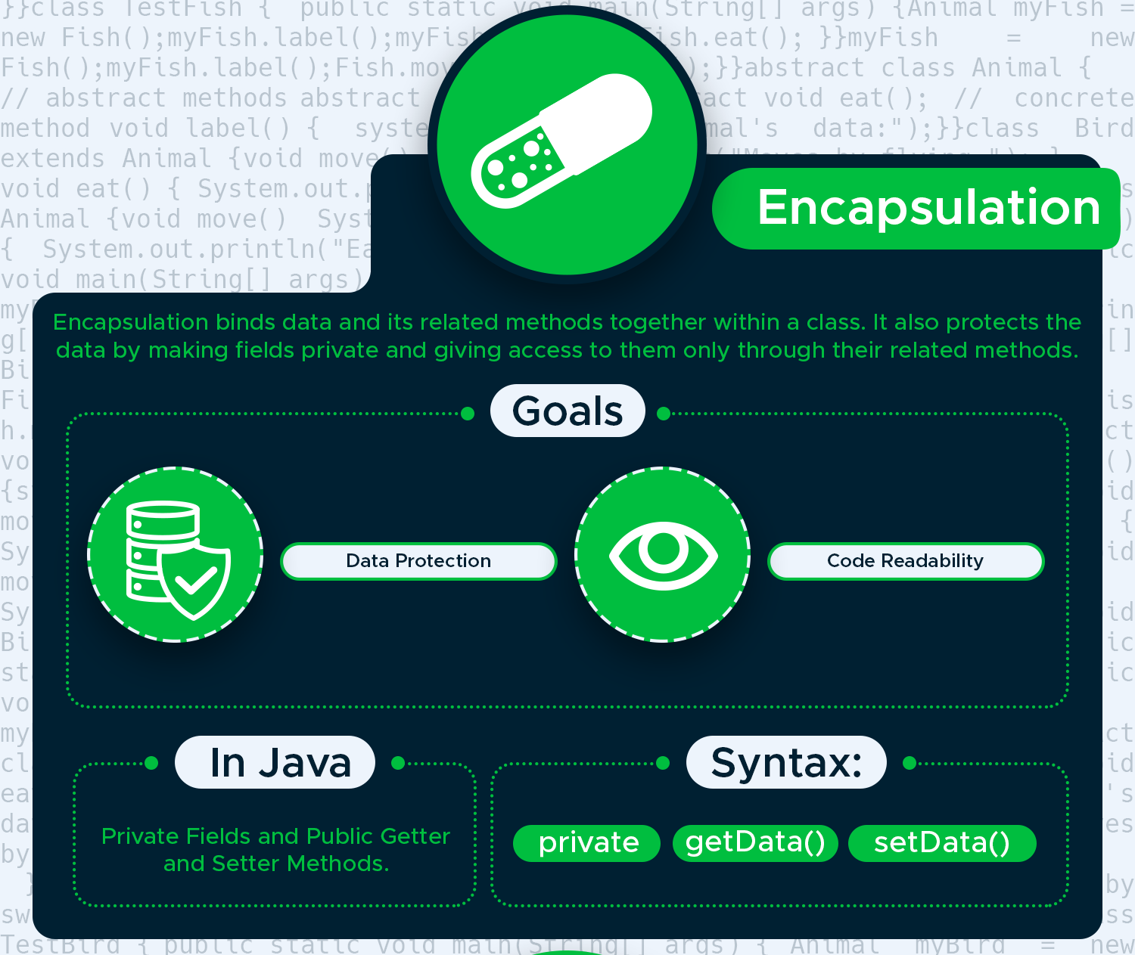
Encapsulation

Slide 9
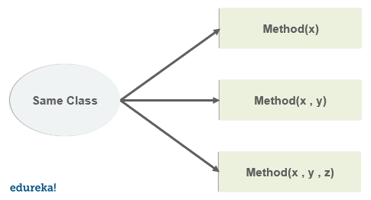
Overloading
Overloading, what you need to know?
Must have different arguments
May have different return type
May have different access modifiers
May throw different exceptions

Slide 10
Overriding
Overriding, what you need to know?
@Override
Final methods can not be overridden
Static methods can not be overridden
Private methods can not be overridden
The overriding method must have same return type (or subtype)
Access-Modifiers

Slide 11
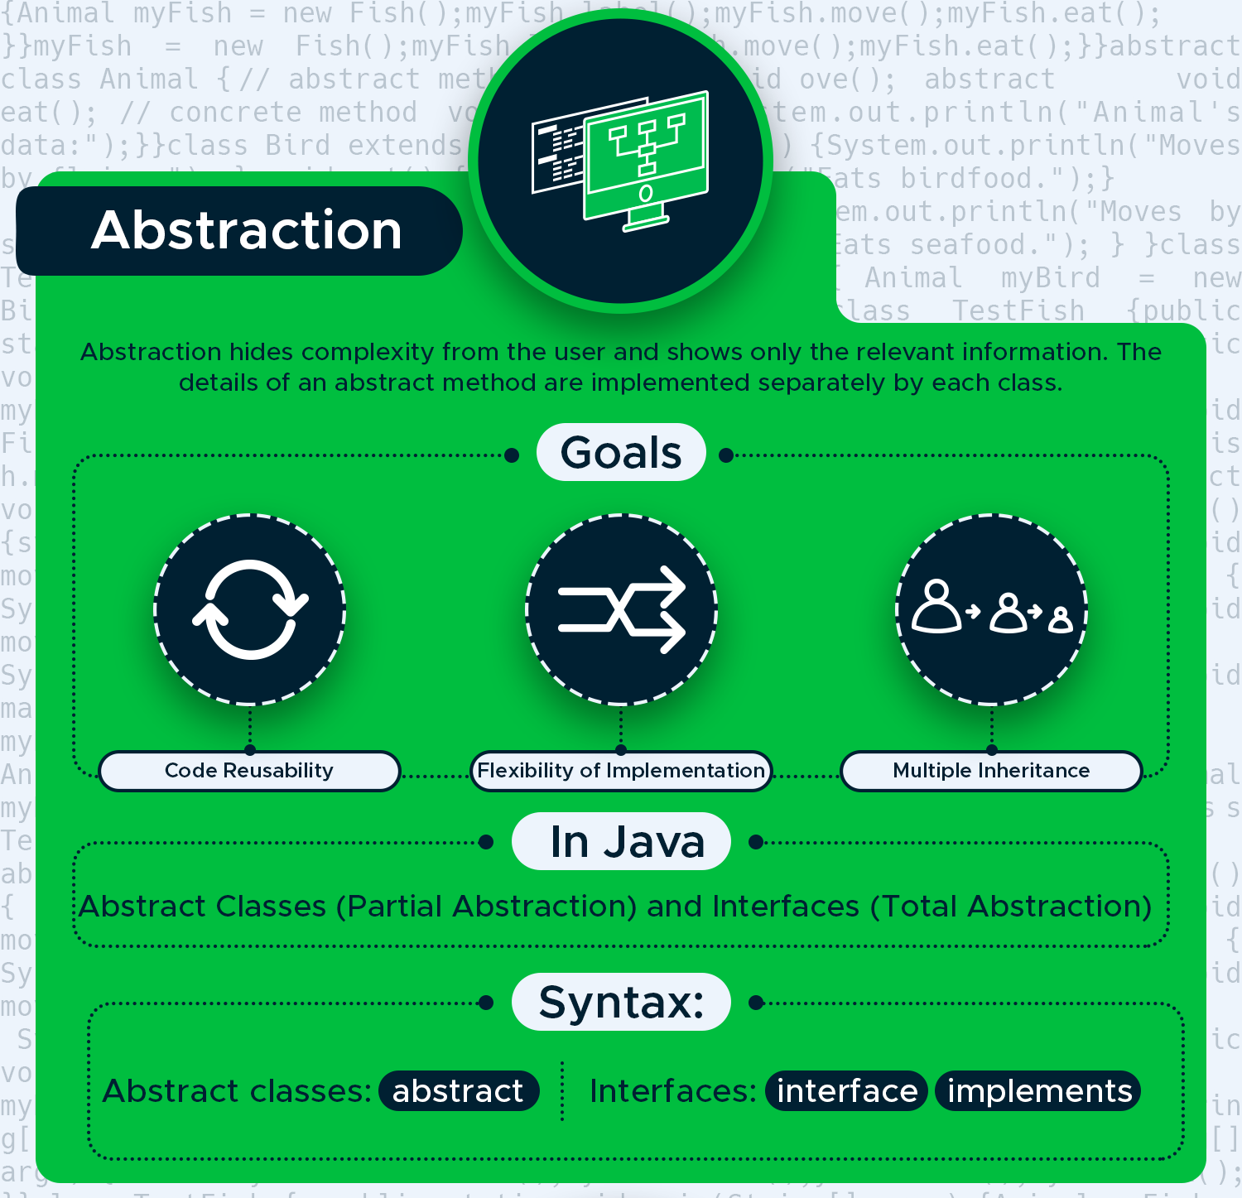
Abstraction
Abstraction, what you need to know?
Abstract class
Interface

Slide 12
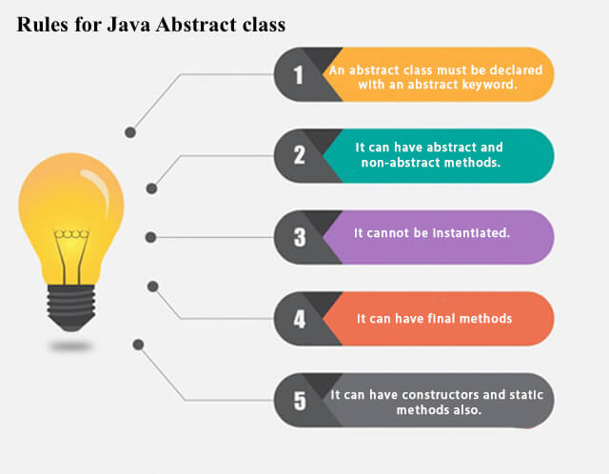
Abstract class

Slide 13
Interface
Interface is a collection of abstract methods.
Contains abstract, default, static methods and nested types.
Contains behaviors that a class implements.
Unless the class that implements the interface is abstract, all the methods of the interface need to be defined in the class.

Slide 14
Interface vs Class
Cannot instantiate.
No constructors.
All of the methods are abstract.
Fields must be declared both static and final.
An interface is not extended by a class; it is implemented by a class.
An interface can extend multiple interfaces.

Slide 15
Interface vs Abstract Class
Interface variables final by default. Abstract class may contain non final variables.
Members of an interface are public by default. Abstract class can have the usual flavors of class members like private, protected, etc..
An interface extends only other interfaces. Abstract class can extend another Java class and implement multiple Java interfaces.
Interface has no state where abstract class can have a state.

Slide 16
Exception, what is that?
Types of exceptions:
Checked
Unchecked
Error
How to handle exception:
try, catch, finally blocks (can be multiple).
Keywords: throw, throws.

Slide 17
Exceptions family

Slide 18
Custom exceptions
Must be children of Throwable.
Checked exceptions must extend Exception class.
Runtime exceptions must extend RuntimeException class.

